Slide 1
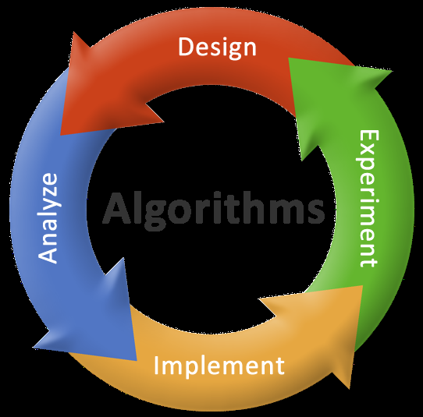
Lesson: 7-8
Introduction to algorithms

Slide 2
Objectives
Introduction to algorithms
Algorithms for simple problems

Slide 3
Algorithm
An algorithm is a step by step procedure to solve a particular problem.
Named after Arabic Mathematician Abu Jafar Mohammed Ibn Musa Al Khowarizmi
Notes:
General additional information on algorithm
In mathematics and computer science, an algorithm is a step-by-step procedure for calculations. Algorithms are used for calculation, data processing, and automated reasoning.
An algorithm is an effective method expressed as a finite list of well-defined instructions for calculating a function.
Starting from an initial state and initial input the instructions describe a computation that, when executed, proceeds through a finite number of well-defined successive states, eventually producing "output" and terminating at a final ending state.

Slide 4
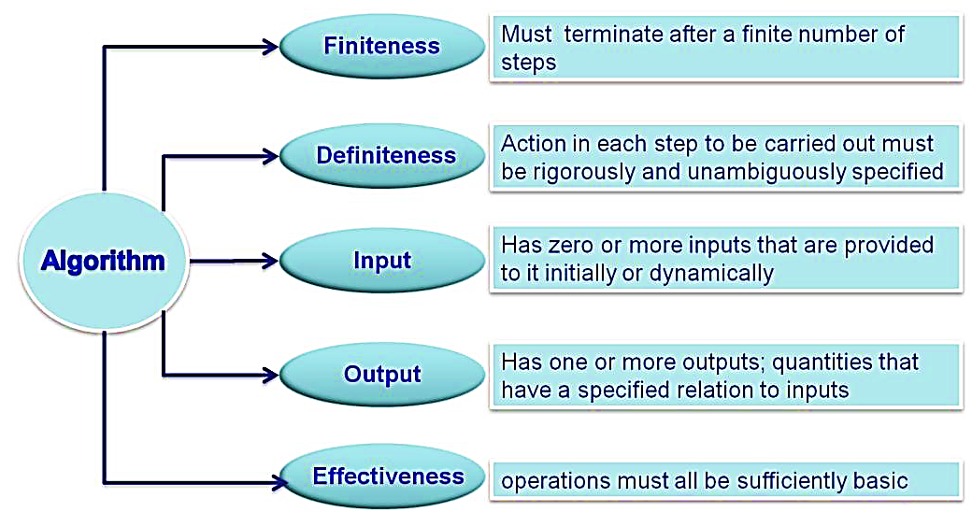
Properties of an algorithm
Notes:
Additional information on properties of algorithms
An algorithm should be
1. Well-ordered: the steps are in a clear order
2. Unambiguous: the operations described are understood by a computing agent without further simplification
3. Effectively computable: the computing agent can actually carry out the operation

Slide 5
Algorithmic Notations
Name of the algorithm [mandatory]
[gives a meaningful name to the algorithm based on the problem]
Step Number [mandatory]
[indicate each individual simple task]
Explanatory comment [optional]
[gives an explanation for each step, if needed]
Termination [mandatory]
[tells the end of algorithm]
Notes:
5
5

Slide 6
Algorithm to compute the area of circle
Name of the algorithm : Compute the area of a circle
Step1: [Input the value for radius]
Input radius
Step 2: [Compute the area]
Area ← 3.1416 * radius * radius
Step 3: [Print the Area]
Print ‘Area of a circle =‘, Area
Step 4: [End of algorithm]
Stop
Notes:
6
6

Slide 7
Data: P=amount deposited T=duration R=rate of interest SI ←(P*R*T)/100 CI ← P*(1+ R/100)^{T} -P
Algorithm to compute Simple and Compound interest

Slide 8
Simple and Compound interest
Name of the algorithm: Calculate SI and CI
Step1: [ Read the values of P, T and R]
Input P,R,T
Step 2: [Compute the simple interest]
SI ← ( P*R*T)/100
Step 3: [Compute the compound interest]
CI ← P*(1+ R/100)^{T} -P
Step 4: [Print the simple and compound interest]
Print ‘Simple Interest=‘,SI
Print ‘Compound Interest=‘,CI
Step 5: [End of Algorithm]
Stop

Slide 9
Convert Cel. to Fahren. & vice versa
Algorithm : To convert Celsius to Fahrenheit & vice versa
Step1: [Input celsius]
Read Celsius
Step 2: [Calculate fahrenheit]
Fahrenheit =(9.0 / 5.0) * Celsius + 32.0
Step 3: [Display computed fahrenheit]
Print ‘temp in Fahrenheit=‘ Fahrenheit
Step 4: [Input fahrenheit]
Read Fahrenheit
Step 5: [Calculate Celsius]
Celsius =(Fahrenheit – 32) * (5.0 / 9)
Step 6: [Display computed celsius]
Print ‘temp in celsius=‘ Celsius
Step 7: Stop

Slide 10
Interchange values of two variables using a temporary variable
Name of the algorithm: Interchange of 2 values
Step1: [Read two values]
Input A,B
Step 2: [Store value of variable A in temporary variable temp] temp ← A
Step 3: [Store value of variable B variable A] A←B
Step 4: [Store value of temporary variable temp in variable B] B ← temp
Step 5: [Print the value of variable A and B]
Print ‘A=’ , A
Print ‘B=’ , B
Step 6: [End of Algorithm]
Stop
Notes:
10
10

Slide 11
Interchange values of two variables without using a temporary variable
Name of the algorithm: Interchange two values without using a temporary variable
Step 1: [Read two values]
Input A,B
Step 2: [Assign sum of A and B to A]
A←A+B
Step 3: [Assign difference of A and B to B]
B←A-B
Step 4: [Assign difference of A and B to a]
A←A-B
Step 5: [Print the value of variable A and B]
Print ‘A=’ , A
Print ‘B=’ , B
Step 6: [End of Algorithm]
Stop
Notes:
11
11

Slide 12
Sum of digits of a 4-digit number
Name of the algorithm: Sum of digits of 4-digit number
Step1: [Read the number]
Input N
Step 2: digit1←N Mod 10
N←N/10 (integer)
Step 3: digit2←N Mod 10
N←N/10 (integer)
Step 4: digit3←N Mod 10
N←N/10 (integer)
Step 5: digit4←N Mod 10
N←N/10 (integer)
Step 6: sum← digit1+digit2+digit3+digit4
Step 7: Print “Sum of digits = “, sum
Step 8: [End of Algorithm]
Stop

Slide 13
Largest of 3 Numbers
Name of the algorithm: Find largest of 3 numbers
Step 1: [Read the values of A, B and C]
Read A, B, C
Step 2: [Compare A and B]
IF A>B go to step 4
Step 3: [Otherwise compare B with C]
IF B>C then
Print ‘B’ is largest’
Else
Print ‘C’ is largest’
Go to Step 5
Step 4: [Compare A and C for largest]
IF A>C then
Print ‘A’ is largest’
Else
Print ‘C’ is largest’
Step 5: [End of the algorithm]
Stop

Slide 14
Sum of first N natural numbers
Name of the algorithm: Sum of natural numbers.
Step1: [Read the value of N]
Input N
Step 2: [Set Sum equal to 0]
Sum ← 0
Step 3: [Compute the sum of all first N natural numbers]
For i=1 to N in step of 1 do
begin
Sum ← Sum + i
end
Step 5: [Print Sum ]
Print ‘Sum of N natural numbers=‘,Sum
Step6: [End of algorithm]
Stop
Notes:
14

Slide 15
Factorial of a number
Name of the algorithm: Compute the factorial of a number N
Step1: [Read the value of N]
Input N
Step 2: [Set variable Fact equal to 1]
Fact ←1
Step 3: [Compute the factorial of N]
for Count = 1 to N in step of 1 do
begin
fact ← fact*Count
end
Step 4: [Print Fact ]
Print ‘fact of N=‘, Fact
Step 5: [End of algorithm]
Stop
Notes:
15
Factorial number
In mathematics, the factorial of a non negative integer n, denoted by n!, is the product of all positive integers less than or equal to n. For example,
5! = 5 x 4 x 3 x 2 x 1 = 120.
The value of 0! is 1, according to the convention for an empty product.

Slide 16
Fibonacci series up to a given limit
Name of the algorithm : Generate Fibonacci Series
Step 1 : [Read the limit]
Input Limit
Step 2: [Assign initial two values to variables]
First←0,Second←1
Step 3: [Print initial two values]
Print First, Second
Step 4: [Compute the remaining Fibonacci numbers]
while Second< Limit
begin
Next ⬅ First + Second
Print Next
First ← Second
Second ← Next
end
Step 5: [End of Algorithm]
Stop
Fibonacci series:
0, 1, 1, 2, 3, 5, 8, 13, 21, …
Notes:
16
Fibonacci numbers
In mathematics, the Fibonacci numbers or Fibonacci series or Fibonacci sequence are the numbers in the following,
0,1,1,2,3,5,8,13….
By definition, the first two numbers in the Fibonacci sequence are 0 and 1, and each subsequent number is the sum of the previous two.
In mathematical terms, the sequence F_{n} of Fibonacci numbers is defined by the recurrence relation
Fn=Fn-1+Fn-2
with seed values,
F0=0 and F1=1.

Slide 17
Count the no of digits of a number
Name of the algorithm: Count the no of digits of a number
Step 1: [Read the number]
Input N
Step 2: [Set variable Count equal to 0]
count ←0
Step 3: [Compute the number of digits]
While N>0
begin
N←N/10 (integer )
count← count+1
end
Step 4 : [Print the number of digits]
Print ‘No. of digits=‘,count
Step 5: [End of Algorithm]
Stop
Notes:
17

Slide 18
Sum of digits of a number
Name of the algorithm: Find sum of the digits of a number
Step 1: [Read the number]
Input N
Step 2: [Set variable Sum equal to 0]
Sum←0
Step 3: [Compute the sum of digits]
While N>0
begin
rem ← N mod 10
sum ← sum + rem
N←N/10 (integer)
end
Step 4: [Print the sum of digits]
Print ‘Sum of the digits of the number=‘,sum
Step 5: : [End of Algorithm]
Stop
Notes:
18

Slide 19
Summary
Introduction to an algorithms
Properties of an algorithm
Algorithms for simple problems

